Slide 1
BOOX: Sprint 4
Camille Pascua - Project Manager
Raheel Jooma - Scrum Master
Charlotte Owen - Programmer 1
Abele Amsalu - Programmer 2
Jonny Martinez - Quality Assurance
Notes:
Jooma

Slide 2
What Is BOOX?
BOOX is a search engine dedicated to finding copyright-free images via the Pixabay API.
Notes:
Camille

Slide 3
What Is Its Purpose?
Users may search for millions of copyright-free and royalty-free images for various purposes such as projects, entertainment, presentations, tutorials, demonstrations, etc. and download them.
Notes:
Jooma

Slide 4
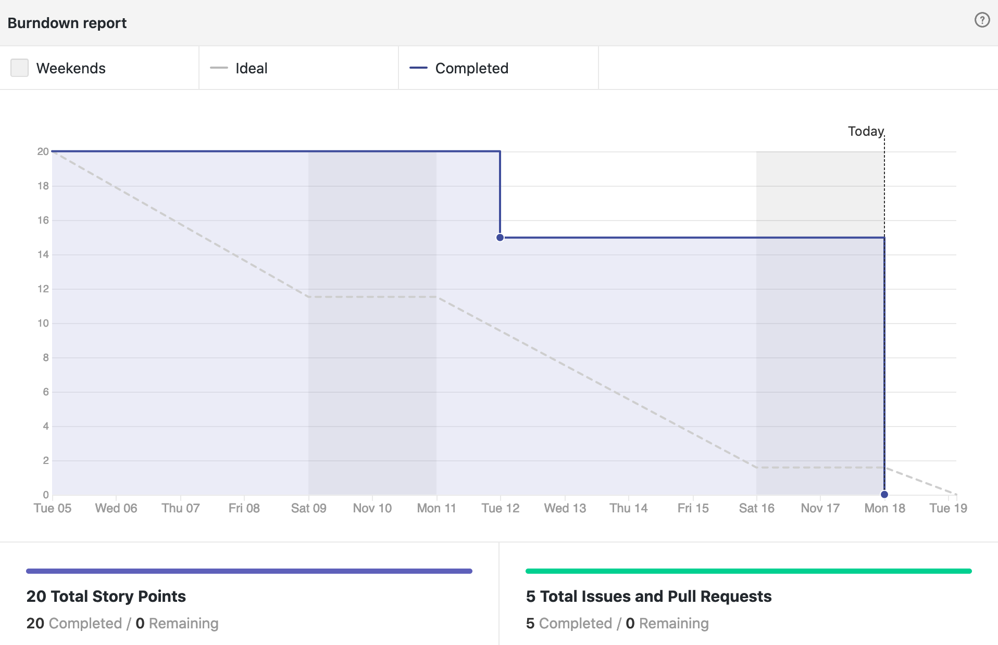
Burn Down Chart
Notes:
Jooma

Slide 5
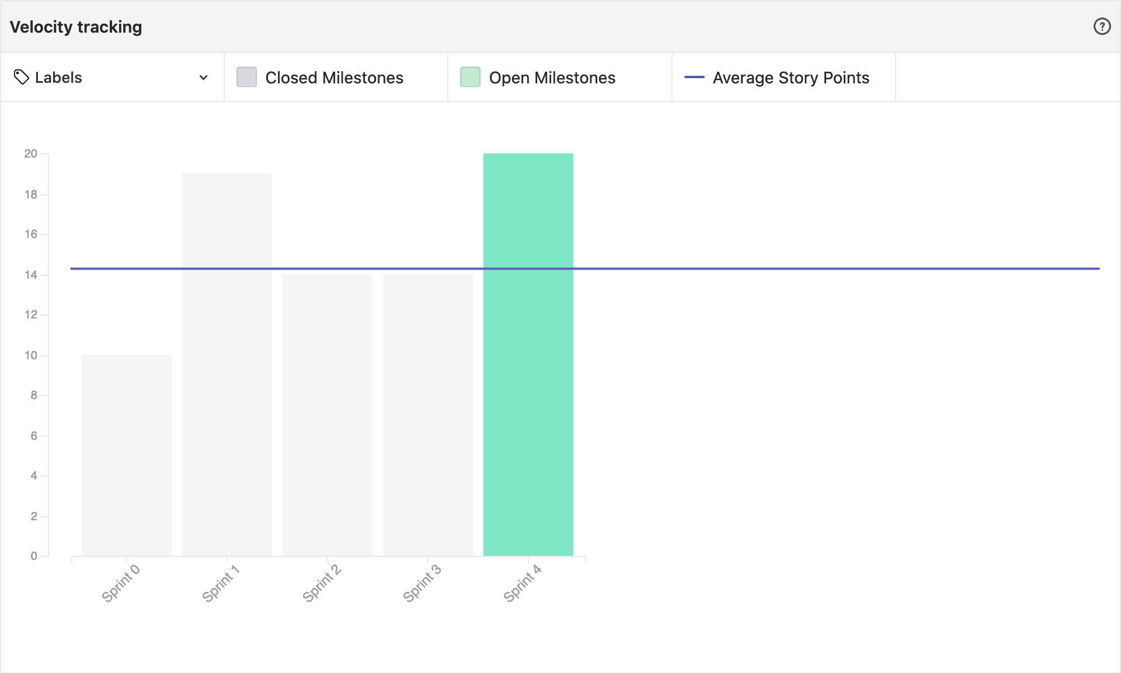
Velocity Chart
Notes:
Camille

Slide 6
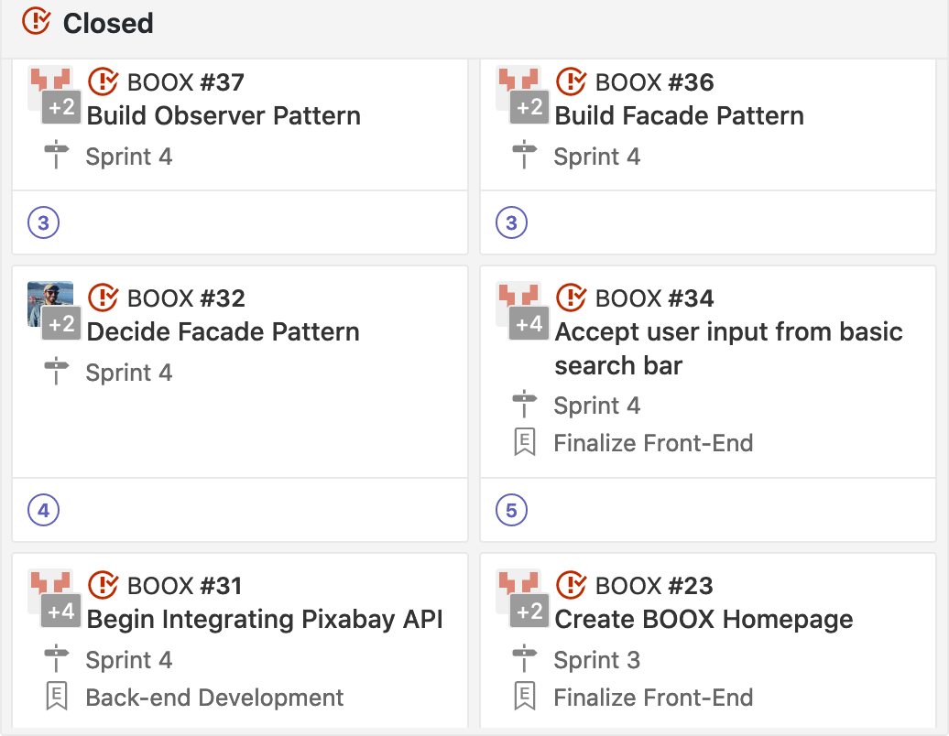
Completed Stories
Notes:
Jooma

Slide 7
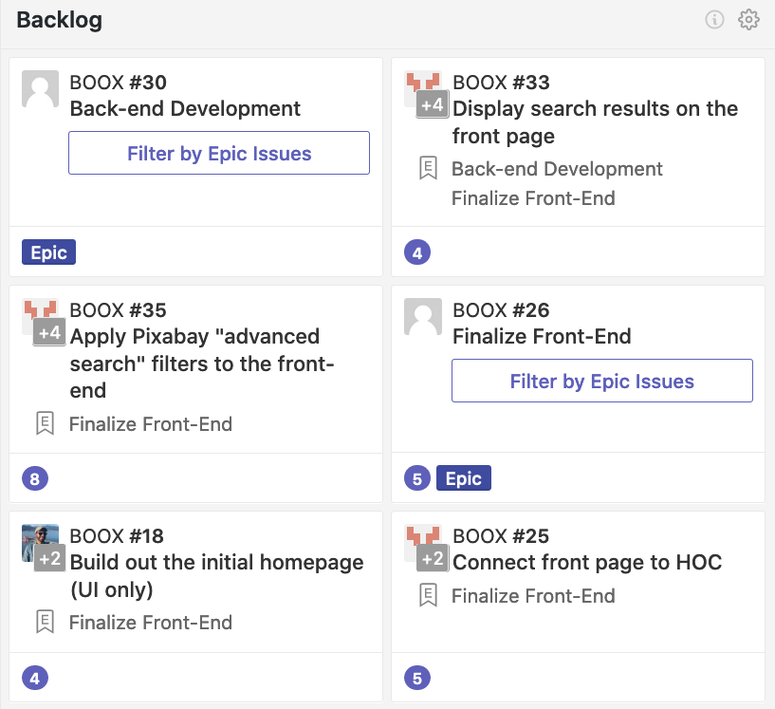
Backlog
Notes:
Camille

Slide 8
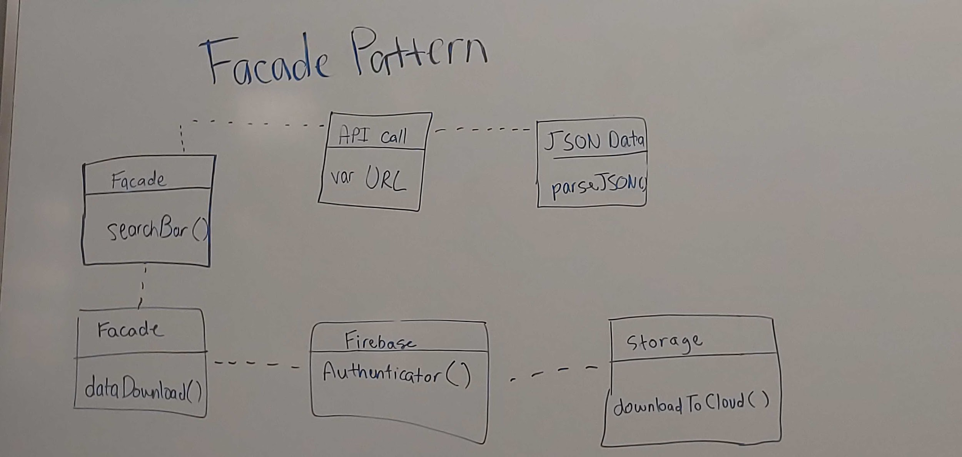
Design Pattern (Facade)
Notes:
Jooma

Slide 9
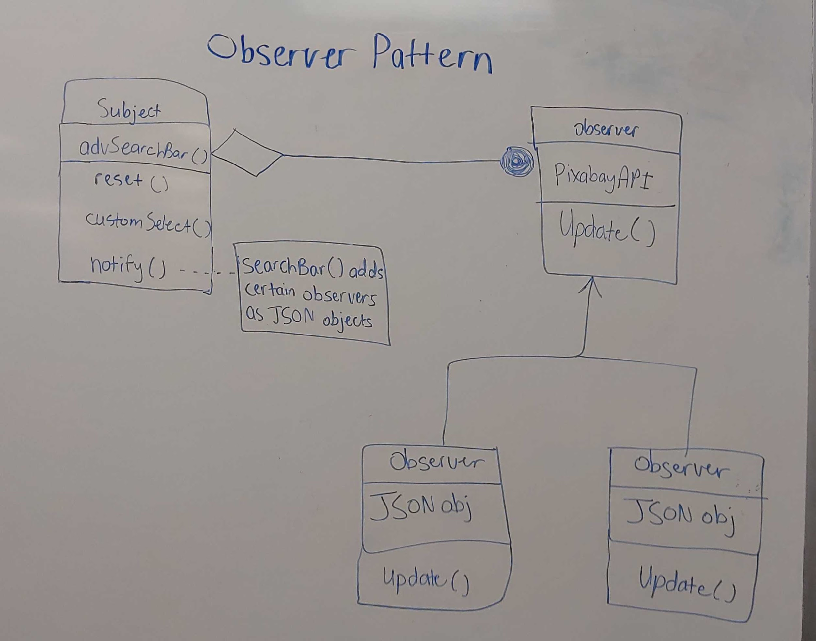
Design Pattern (Observer)
Notes:
Camille

